Slide 1
Effects of Smoking and Air Pollution on Cardiovascular Diseases By: Team RESPY

Slide 2
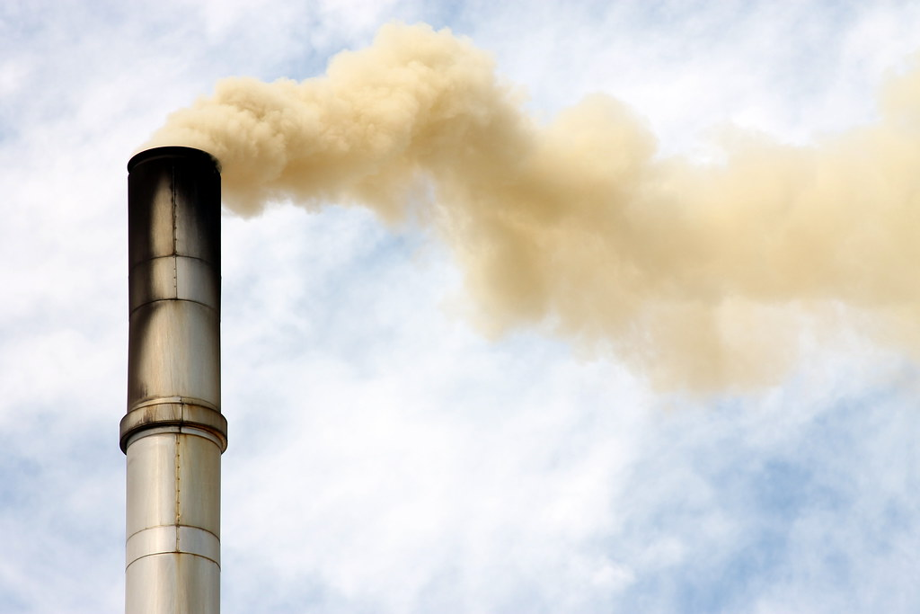
Index
Team Background/Role
Objective
Project Overview/Data Sources
Steps/Tools
Demo
Analysis
Future Considerations
Q&A

Slide 3

Meet the Team
TEAM RESPY
Krithika
Wilson
Wissemeddine
Raphael
Rishi

Slide 4


Objective
To show whether or not there was a correlation between the type of smoker and number of cardiovascular deaths.
To show if there was a correlation between air pollution and cardiovascular deaths.

Slide 5
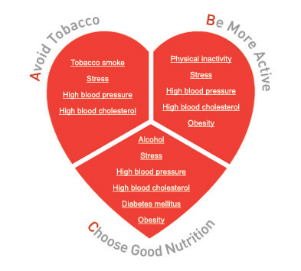
Project Overview
Visualizations of smoking data, air pollution, and cardiovascular disease/mortality rates for users to explore the data themselves.
Tools Used: Python Flask, HTML, JavaScript, MongoDB.
Combination of Plotly and Leaflet

Slide 6



Steps
Find Data Sources:
BRFSS Prevalence and Trends Data: Tobacco Use (https://data.cdc.gov/Smoking-Tobacco-Use/BRFSS-Prevalence-and-Trends-Data-Tobacco-Use-Four-/ya9m-pyut/data)
Air Quality Programmatic APIs (https://aqicn.org/api/)
National Cardiovascular Disease Mortality Rates (https://data.cdc.gov/Heart-Disease-Stroke-Prevention/National-Vital-Statistics-System-NVSS-National-Car/kztq-p2jf)
Create Maps using D3 and Leaflet.js
Create HTML website using Python Flask

Slide 7
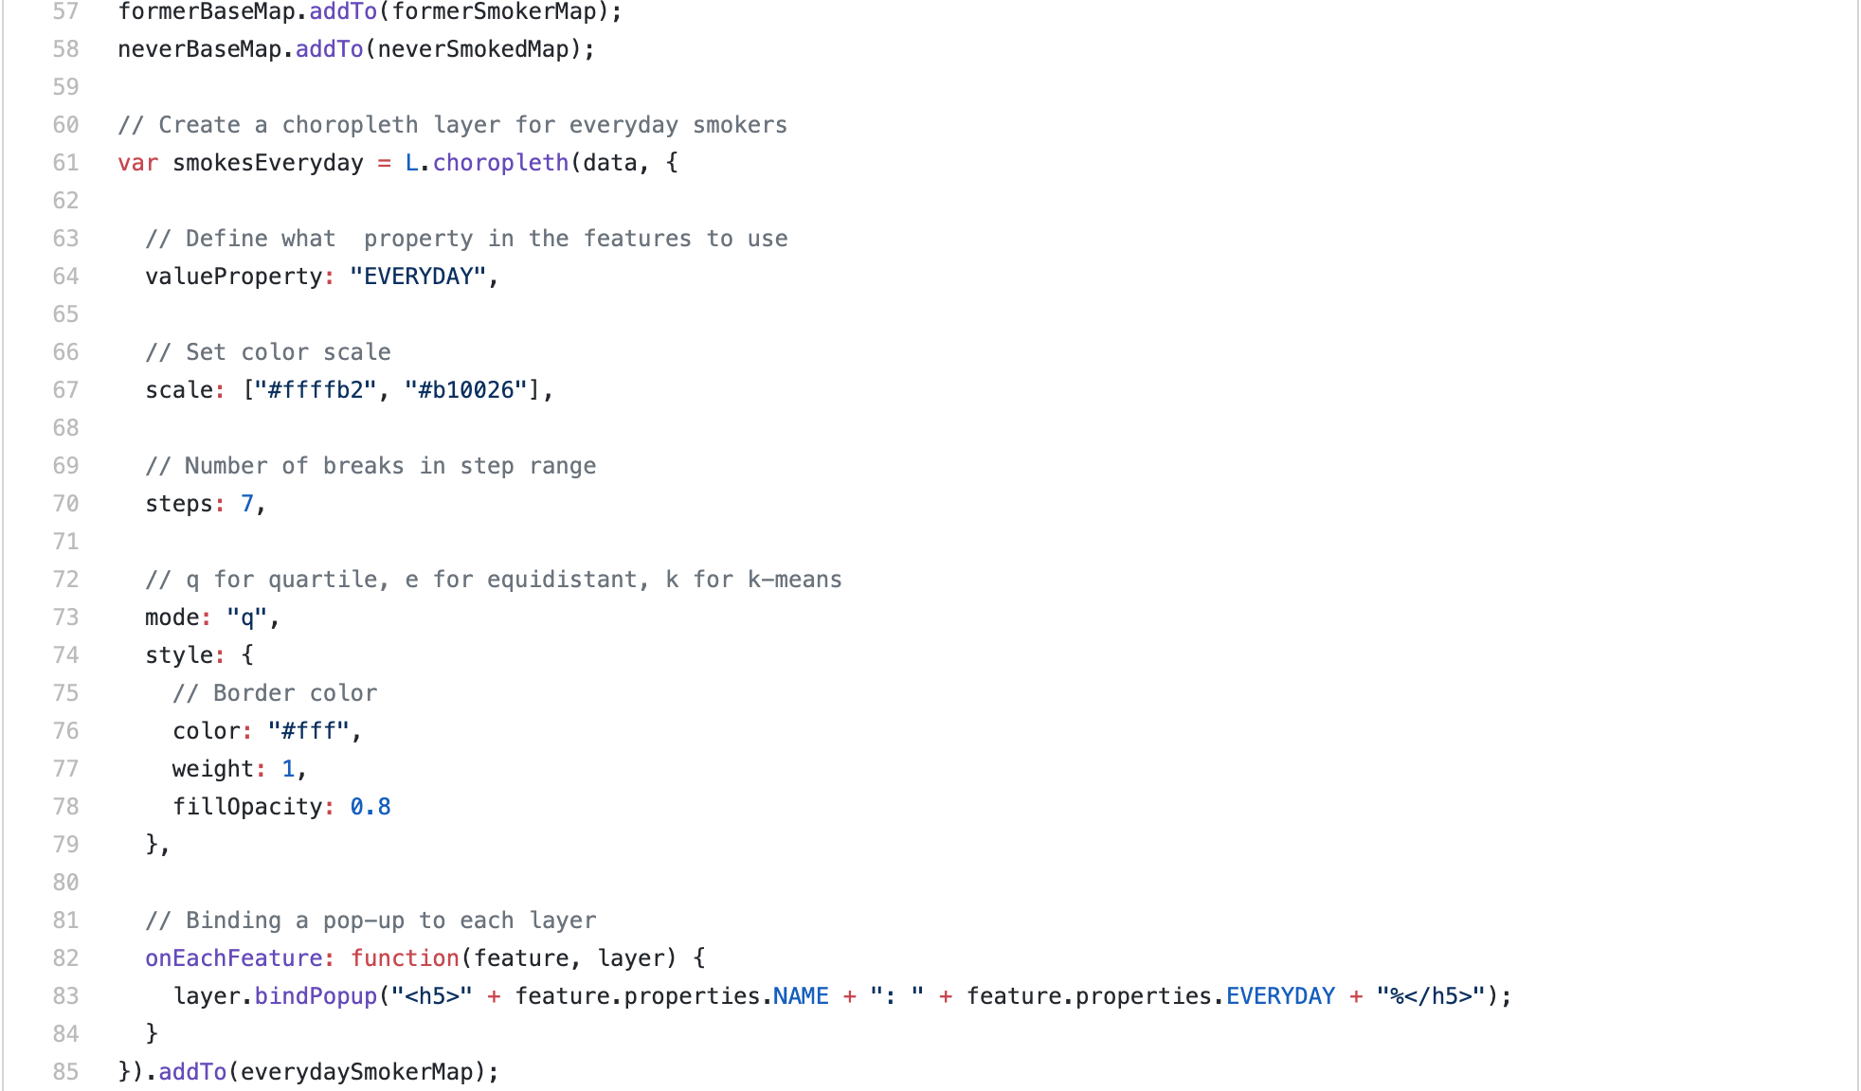
Demo

Slide 8

Analysis
The more often people smoke, the higher the chance is that they will have a cardiovascular related death
Air pollution did not have a direct correlation with cardiovascular related deaths.

Slide 9

Future Work
Tool bar for local air pollution
Overlapping map for each data set
Multiple data sets (Last 10 years of data)
Life expectancy for each data set

Slide 10
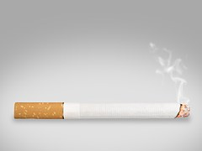
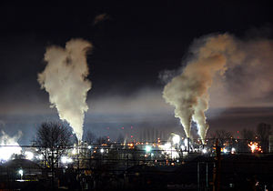
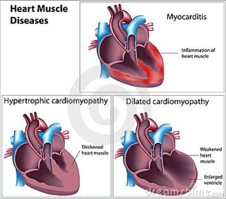
Q & A

